Slide 1
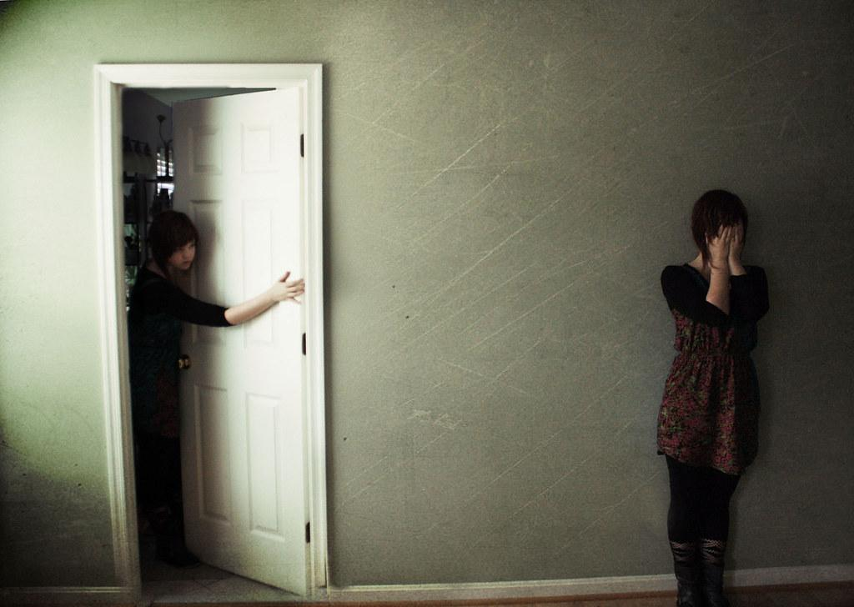
Steganography
Hiding in Plain Sight

Slide 2


Obfuscation
The process of making something unclear
Making something difficult to understand, but not impossible
Often done with source code, making it difficult to read for the common person.
Functionality stays the same.
Video games, CD PROJEKT RED

Slide 3

Steganography
Greek for “concealed writing”
Security through obscurity, not a true security method.
If someone knew the process of hiding the message, it can easily be reverse engineered.
Hiding information inside of an image
There is actually a message there, it's just invisible!

Slide 4
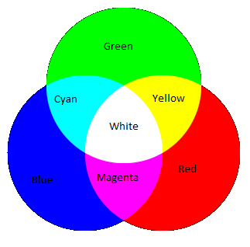
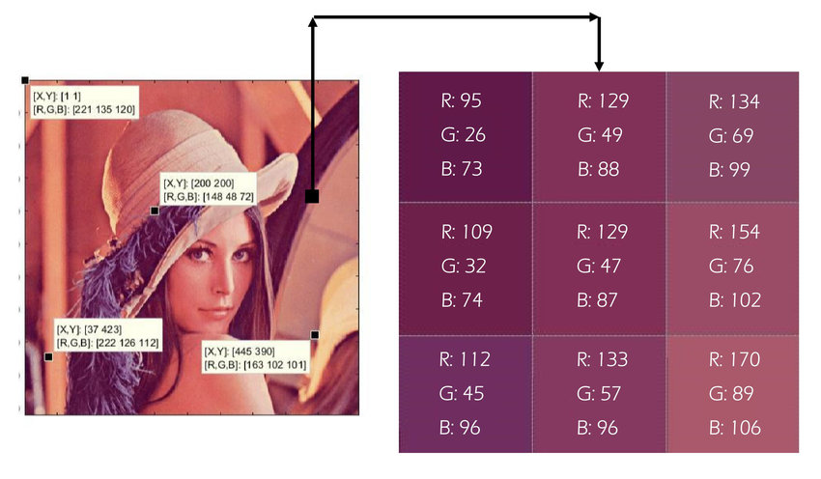
Aspects of an Image
Every image has a different amount of pixels (Length x Width)
1280 x 720 (720p) - 921,600 pixels
1920 x 1080 (1080p) - 2,073,600 pixels
3840 x 2160 (4K) - 8,294,400 pixels
Each pixel can have a value ranging from (0-255, 0-255, 0-255)
(Red, Green, Blue) RGB!!
These pixels can be manipulated to hide secret messages.

Slide 5
Examples of Steganography
Image Stego
Hiding messages in messages, we just went over this!
Network-based Stego
You’ll be learning more about this soon!
Adding information to packets going across your network. When all the packets are captured in a program like *Wireshark*, you can put them together to form a hidden message.
Invisible watermarks
Mainly used by companies.
If you ever printed something, there is an invisible watermark detailing what kind of printer was used.

Slide 6

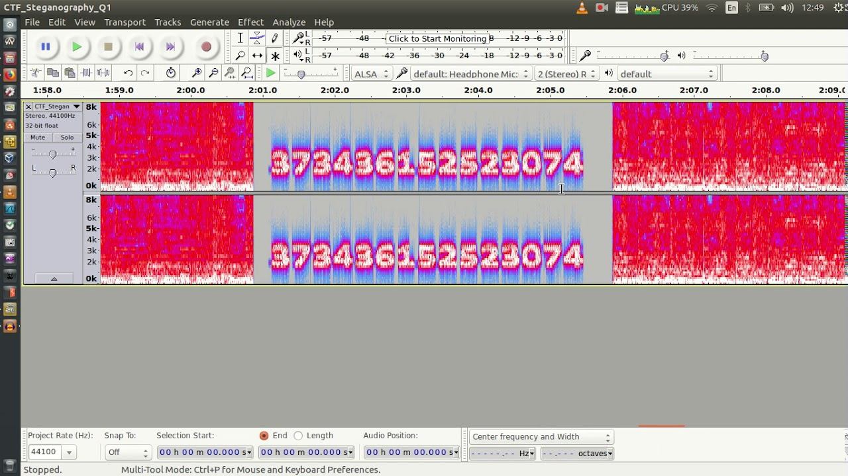
Examples of Steganography (Cont.)
Audio Stego (https://drive.google.com/file/d/1AjTpeOtkfQmuqnj4zudLkEKKFHnDbvK1/view?usp=sharing)
Hidden messages in audio! Can you understand what is being said?
Similar technique to image stego, the hidden message is actually within the audio itself.
Video Stego
A sequence of images layed on top of each other.
Video’s support a larger format, longer messages are usually stored using this method.
Notes:
https://morsecode.world/international/decoder/audio-decoder-adaptive.html

Slide 7
Questions?
LIVE DEMO!

Slide 8

Tools Used in Steganography
Digital Invisible Ink Toolkit (DIIT): http://diit.sourceforge.net/
Stepic
Stegsolve
Jeffrey’s EXIF Tool: http://exif.regex.info/exif.cgi
Audacity

Slide 9
Digital Invisible Ink Toolkit (DiiT)
Uses one of four different algorithms to hide a message in a message:
BlindHide
This is the simplest way to hide information in an image.
It blindly hides because it just starts at the top left corner of the image and works it's way across the image (then down - in scan lines) pixel by pixel. As it goes along it changes the least significant bits of the pixel colours to match the message.
HideSeek
This algorithm randomly distributes the message across the image.
It is named after "Hide and Seek" - a Windows 95 steganography tool that uses a similar technique.
It uses a password to generate a random seed, then uses this seed to pick the first position to hide in.
It continues to randomly generate positions until it has finished hiding the message.
Notes:
http://diit.sourceforge.net/doco.html

Slide 10
Digital Invisible Ink Toolkit (DiiT) (cont.)
FilterFirst
This algorithm filters the image using one of the inbuilt filters and then hides in the highest filter values first.
A fancier version of BlindHide as it doesn't require a password to retrieve the message. Because we are changing the pixels we need to be careful about filtering the picture because we don't want to use information for filtering that might change. If we do, then it may be difficult (if not impossible) to retrieve the message again. So this algorithm filters the most significant bits, and leaves the least significant bits to be changed. It is less noticeable on an image because using the filter ensures we are hiding in the parts of the image that are the least noticeable.
BattleSteg
The BEST algorithm to use!
This algorithm performs "Battleship Steganography".
It first filters the image then uses the highest filter values as "ships". The algorithm then randomly "shoots" at the image (like in HideSeek) and when it finds a "ship" it clusters it's shots around that hit in the hope of "sinking" the "ship". After a while it moves away to look for other ships. The effect this has is that the message is randomly hidden, but often hidden in the "best" parts to hide in thanks to the ships. It moves away to look for other ships so that we don't degrade an area of an image too greatly. It is secure because you need a password to retrieve the message. It is fairly effective because it is hiding (if you set the values right) the majority of the information in the best areas.
Dynamic BattleSteg and FilterFirst
These two algorithms do the same as BattleSteg and FilterFirst, except they use dynamic programming to make the hiding process faster and less memory intensive.
They are NOT compatible with the original algorithms because the order of pixels kept in the dynamic array is not exactly the same.
Notes:
http://diit.sourceforge.net/doco.html

Slide 11
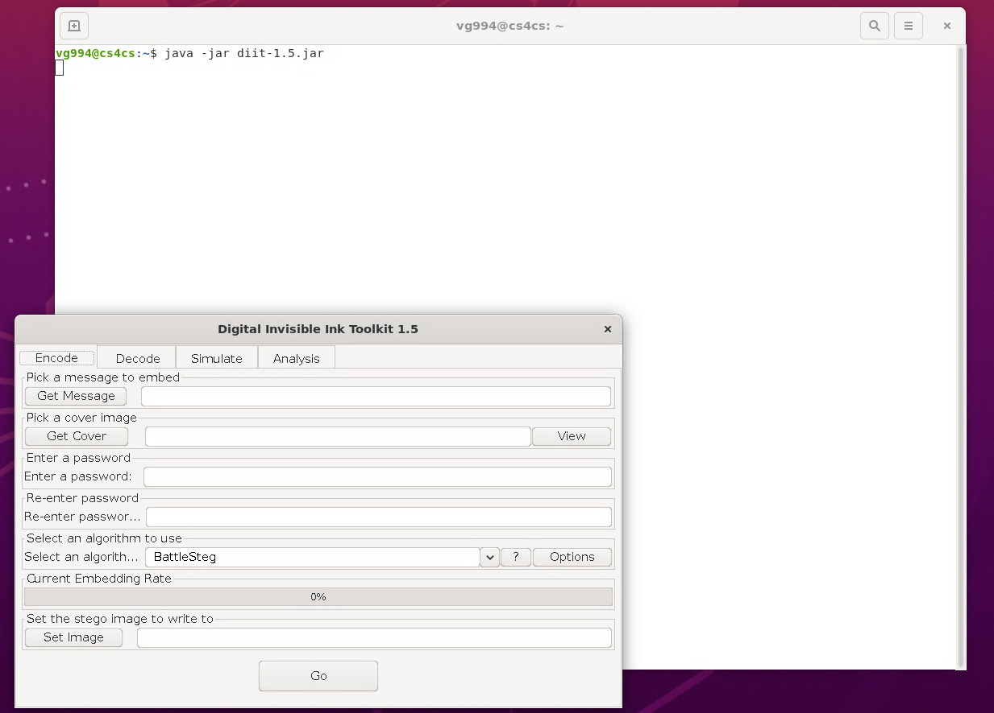
DiiT Problem 1 (Encryption)
I want you guys to encrypt you own images!
Put any kind of message you want in any image you want and have you friends try to decrypt it.
KEEP IT PG, please!
Open your terminal is FastX and type the following command:
‘java -jar diit-1.5.jar’

Slide 12

DiiT Problem 2 (Decryption)
Now….. my turn
Go here, and see what you can find using DiiT: https://drive.google.com/file/d/1xsWBIUfZn8iWNR-gMV3VLq9rHvbw-zh2/view?usp=sharing

Slide 13
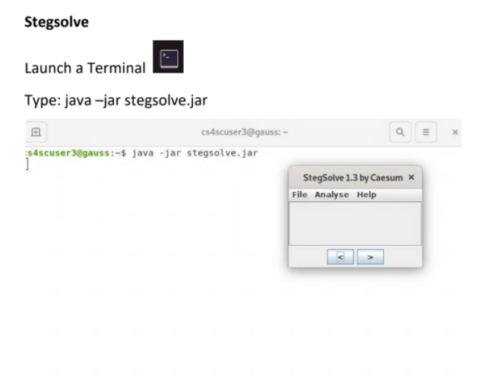
Stegsolve
Used to find hidden messages in images, literally!
Lets practice, see what you can find in this image: https://drive.google.com/file/d/13hfHr_e6lRWdDGR6PnB4dC36xXwOj_nT/view?usp=sharing

Slide 14
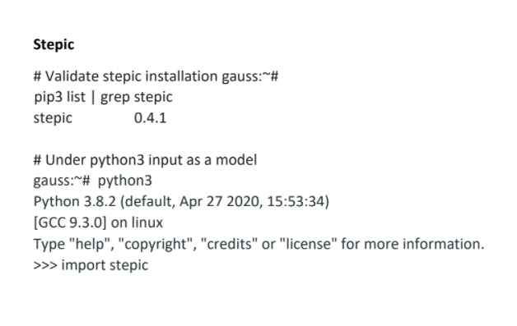
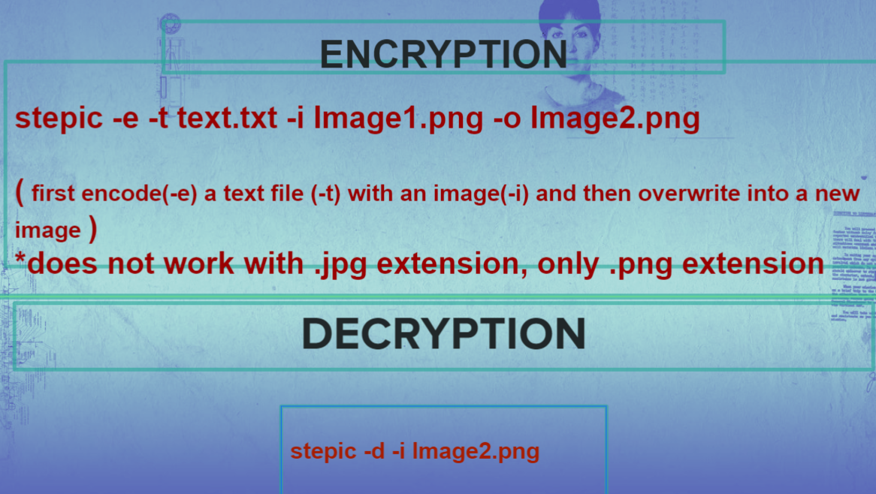
Stepic

Slide 15
Jeffrey’s EXIF Tool
EXIF stands for ‘Exchangeable image file format’.
EVERY image has this kind of data unless it is removed manually.
This data contains any kind of information you can think of like:
Location
What kind of camera you used to take the image
What time the image was taken
You are going to find this information now!
https://drive.google.com/file/d/159Pn7NWhD6c5HS7eSJqBSslIeFvZ-HAl/view?usp=sharing
https://drive.google.com/file/d/16KCh88I9aUeVS_r7DPLUoyvj3cTKAVHL/view?usp=sharing

